Slide 1
How to: SceneBuilder
for Intellij JavaFX projects

Slide 2
We will cover:
Download and installation
Setting up a JavaFX project
Linking your FXML file to your JavaFX project
How to use SceneBuilder

Slide 3
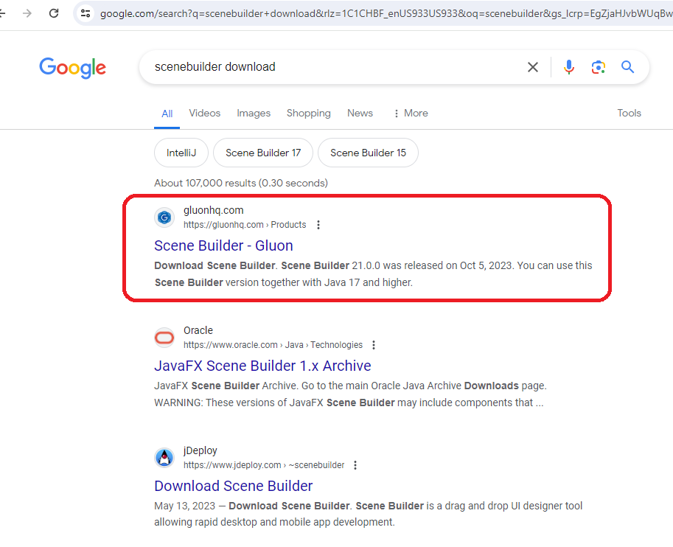
Download and Installation

Slide 4
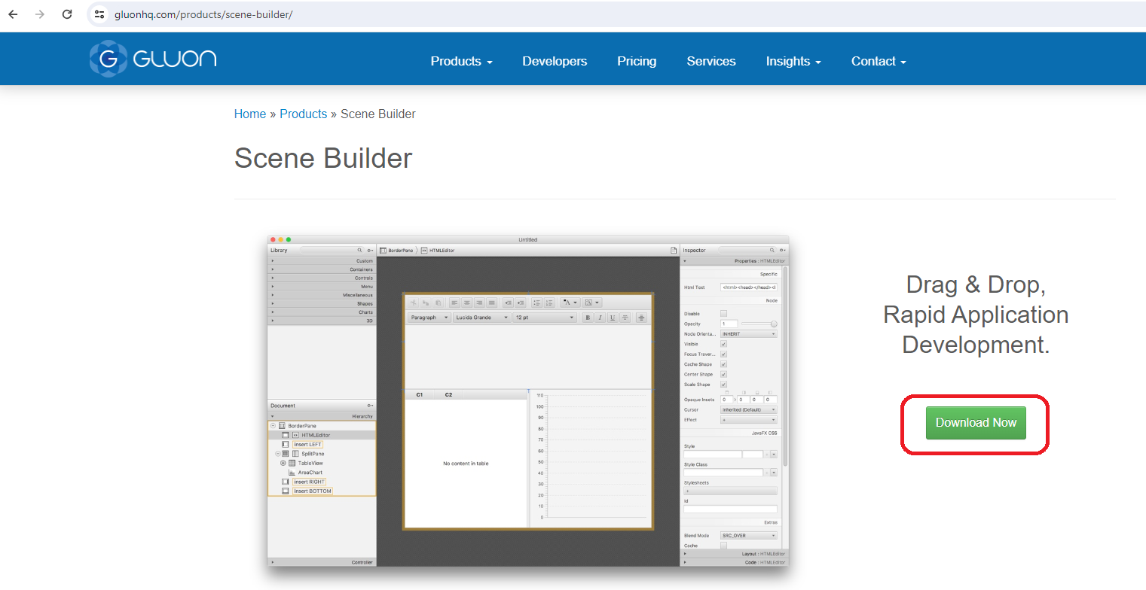
Download and Installation

Slide 5
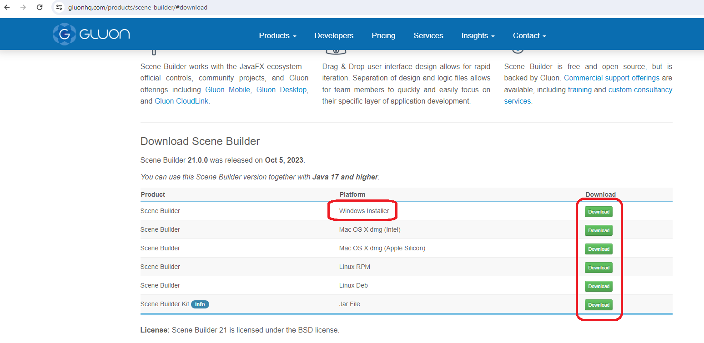
Download and Installation

Slide 6
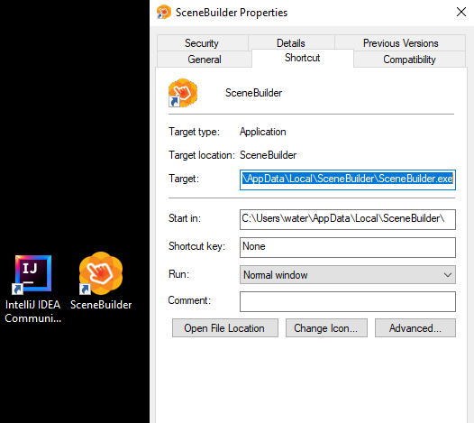
Download and Installation
Once downloaded, find the path to your SceneBuilder executable. You will use this information later. This can be done by:
Locating the SceneBuilder.exe file from its install location. This is usually: C:\Users\<your_login>\AppData\Local\SceneBuilder\SceneBuilder.exe
Or by right-clicking the shortcut on your desktop and finding the path as shown on the right.

Slide 7
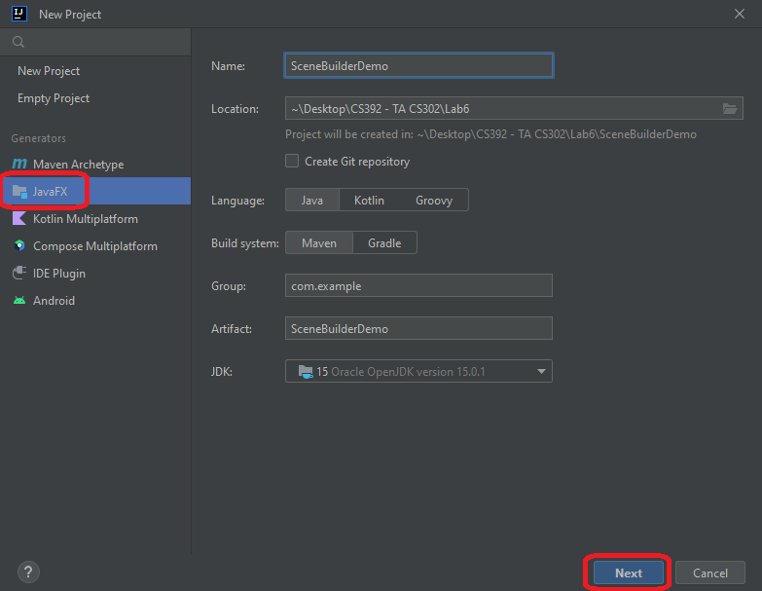
Setting up a JavaFX project
This process is like setting up any JavaFX project; however, there may be some less familiar with JavaFX and IntelliJ.
Make sure to select JavaFX from the tree on the left, under “Generators.” Also be sure that the language, file path location for the project, group path, and JDK are correct.
Now hit “Next.”

Slide 8
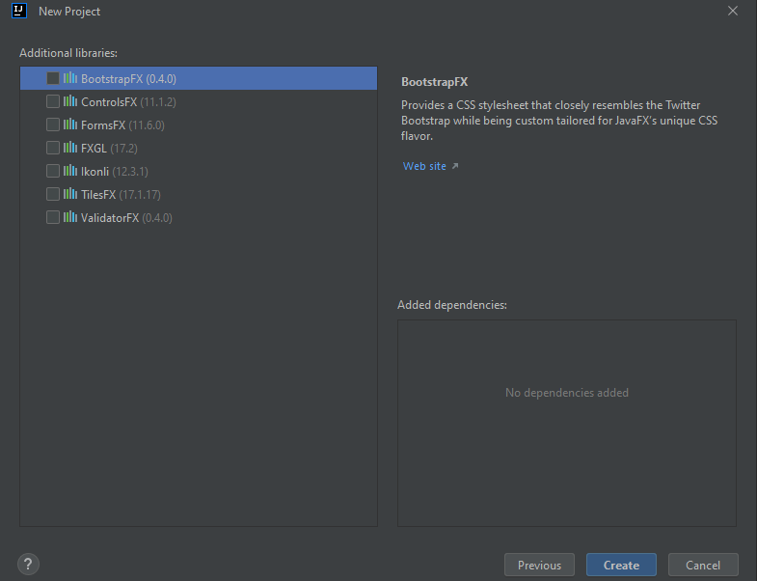
Setting up a JavaFX project
Once you arrive at this screen, make sure to select any additional libraries your project may require. None are necessary for SceneBuilder specifically, but this will allow IntelliJ to build your project more smoothly and with less resulting issues.
Go ahead and hit “Create.”

Slide 9
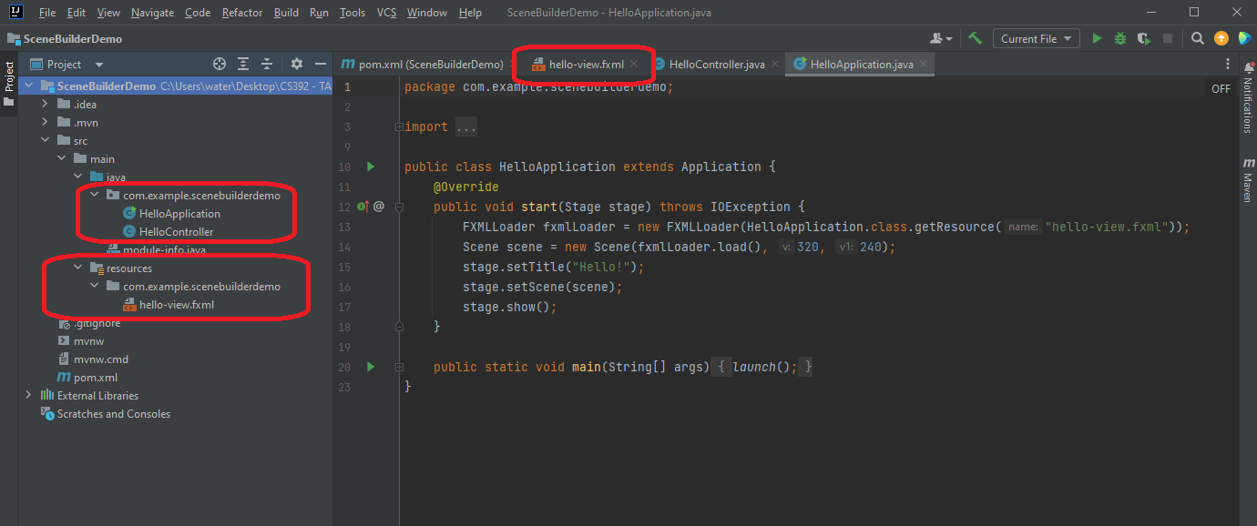
Linking your FXML file to your JavaFX project
Notes:
Three important things to be aware of:
Your Application class or classes (Drivers, Object classes)
Your Controller class (Links functionality built in the FXML file to the rest of the Application classes for the GUI)
Your FXML file (Know where it is; however, it is only going to be modified by SceneBuilder)

Slide 10
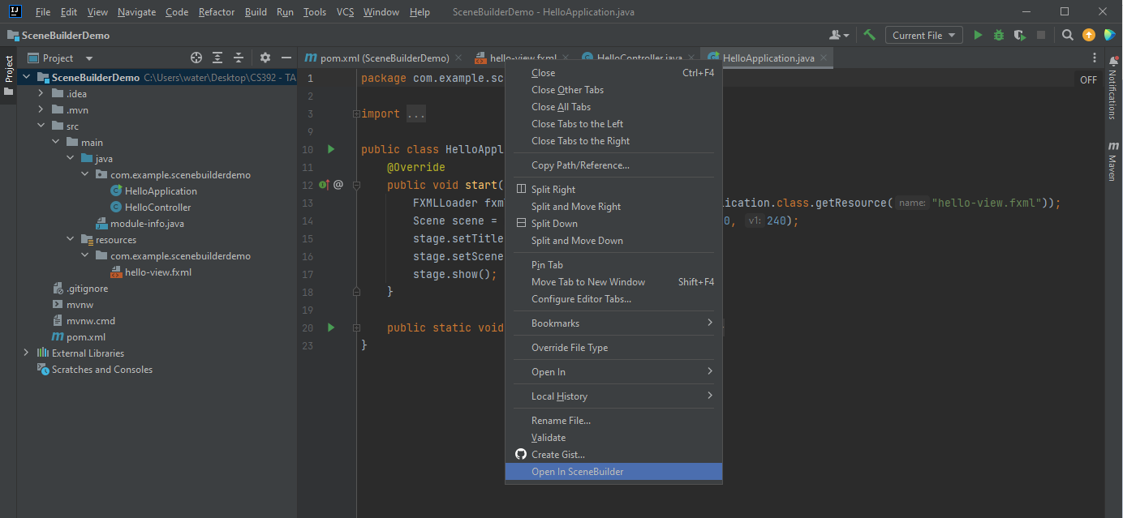
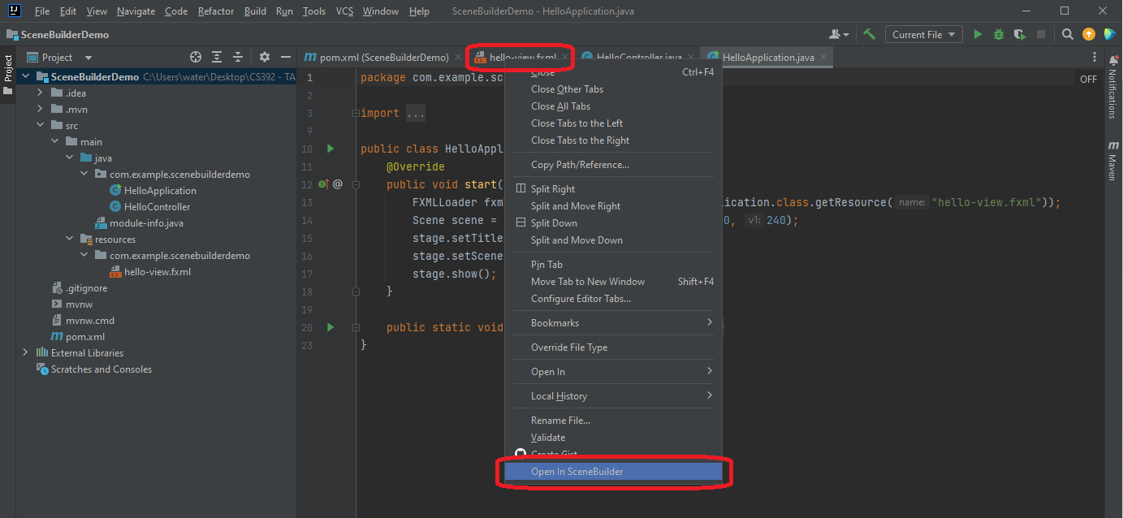
Linking your FXML file to your JavaFX project

Slide 11
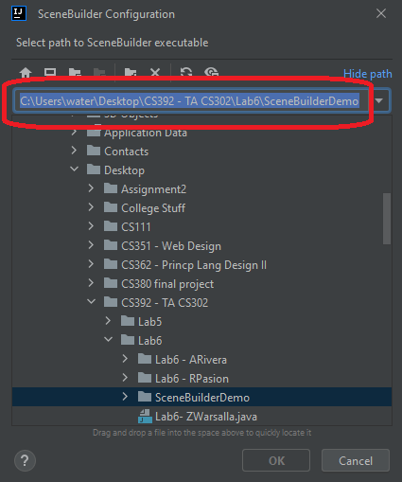
Linking your FXML file to your JavaFX project
Once you have selected “Open in SceneBuilder” this dialogue box will appear. The path it is asking for is the path we found earlier which points to the location of your SceneBuilder executable.
Make sure the full file path exists and that that “SceneBuilder.exe” is at the end of the path.
Example path:
C:\Users\<user_login>\AppData\Local\SceneBuilder\SceneBuilder.exe

Slide 12
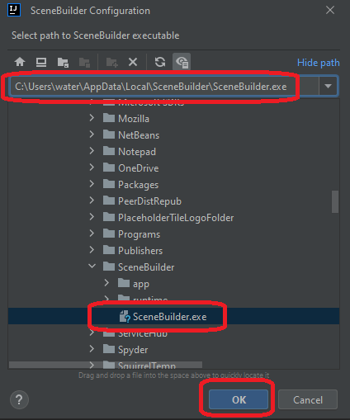
Linking your FXML file to your JavaFX project
Verify this is correct and hit “OK.”
This will launch the SceneBuilder application from IntelliJ.

Slide 13
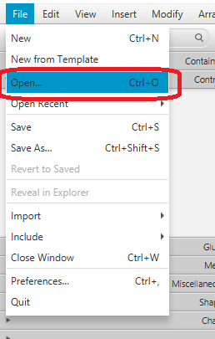
Linking your FXML file to your JavaFX project
Alternately, you can open any FXML file as a standalone in SceneBuilder and it will update your controller class once linked, even if IntelliJ is not running.
Simply open an FXML file from your project in the SceneBuilder application as you would most files, as shown on the right.

Slide 14
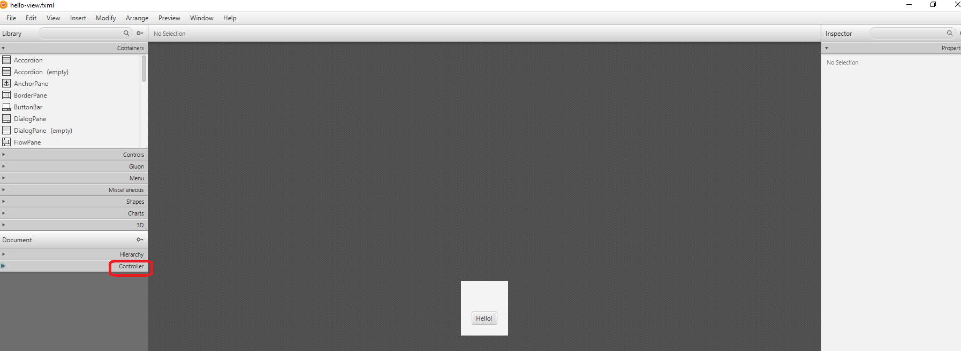
Linking your FXML file to your JavaFX project
Now that we have an FXML file from your project which is open in SceneBuilder, we need to link it to your controller class in the project.
Select “Controller” at the bottom right to expand the section.

Slide 15
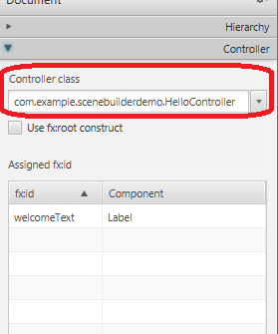
Linking your FXML file to your JavaFX project
Make sure the filed for the controller class points to its location in your project.
The fx:id assignments you make to objects in SceneBuilder will dynamically populate in the table below.
Note: A project may have more than one FXML and controller class, depending on how many views you use. Check that you are using the right one!

Slide 16
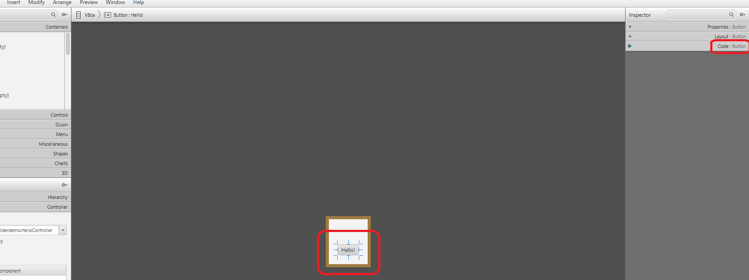
Linking your FXML file to your JavaFX project
Objects you create through SceneBuilder need to be given an fx:id.
To do this, place the object you wish to use on the scene, select it, then expand the “Code” section on the right as shown.

Slide 17
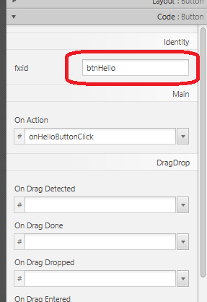
Linking your FXML file to your JavaFX project
The fx:id you set will be the object name for the variable within your Java file.
Here, we have named the button which was selected “btnHello.”
As we continue you will see how this is used in your project.

Slide 18
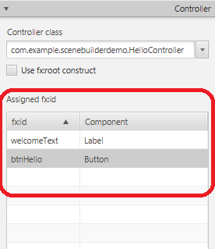
Linking your FXML file to your JavaFX project
To check that you have correctly set up the object, you can find it updated in the bottom left where we linked to the controller class.
btnHello is here and it is a Button object, so we know we are on track.

Slide 19
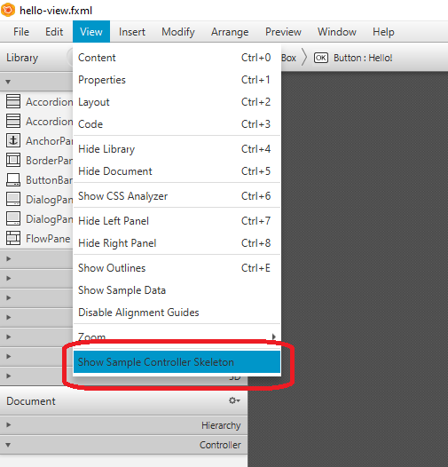
Linking your FXML file to your JavaFX project
As you add objects to your GUI you will need to update your controller class built by the JavaFX project in IntelliJ.
To do so, select “View” then “Show Sample Controller Skeleton.”

Slide 20
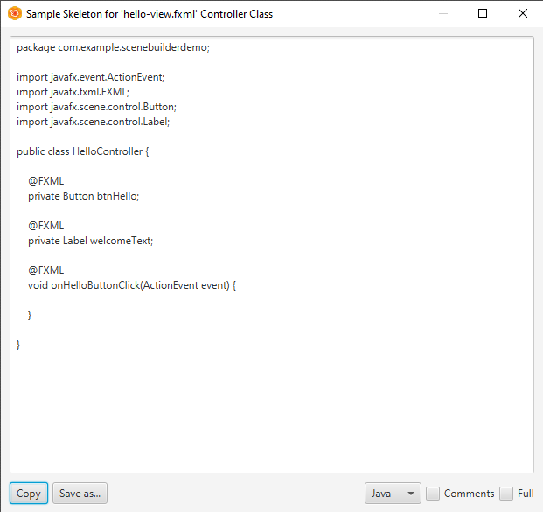
Linking your FXML file to your JavaFX project
Scenebuilder has built the skeleton for your controller class.
The objects have been declared, and the event handler for clicking btnHello has been templated.

Slide 21
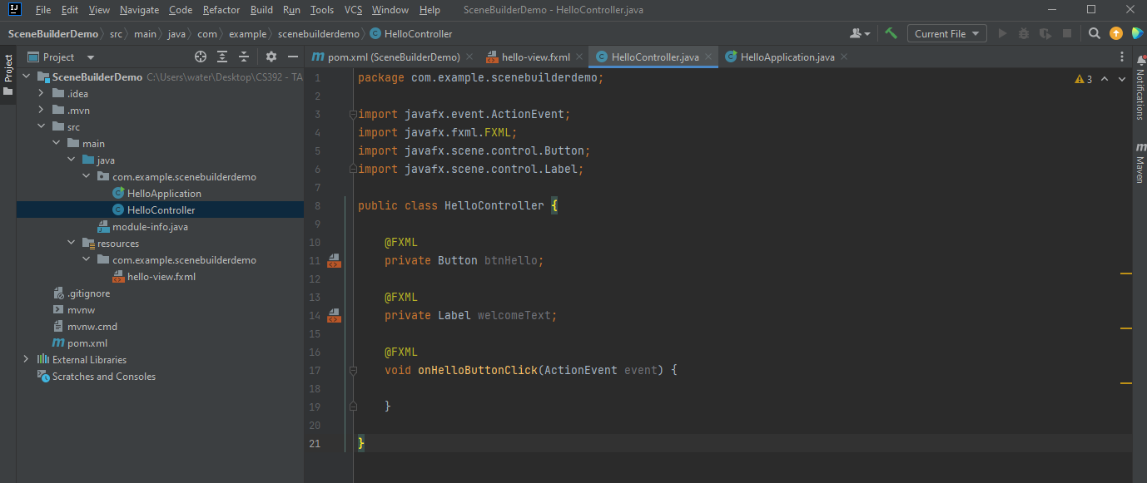
Linking your FXML file to your JavaFX project
Make sure to update your Controller class after making changes to your project as shown below.
That’s all you need to know starting out. Next, we will see some of the functionality SceneBuilder has to offer.

Slide 22
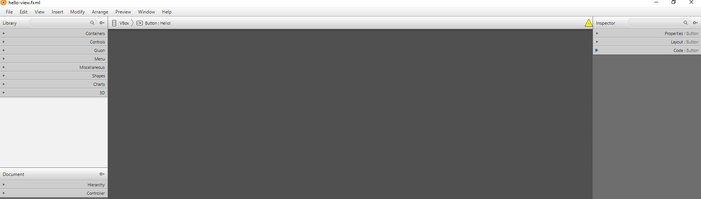
How to use SceneBuilder
The left side of the navigation handles objects you can drag and drop, as well as their layering.
The right side modifies the properties of selected objects.
First, we will overview the left side.

Slide 23
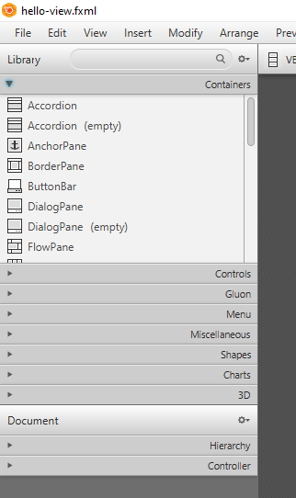
How to use SceneBuilder
Selecting “Containers” expands the area where you can select panes and other bases for object placement.
Click the desired container and drag to the stage to place it.
Each accordion menu contains a list of objects or containers which can be interacted with in this way.

Slide 24
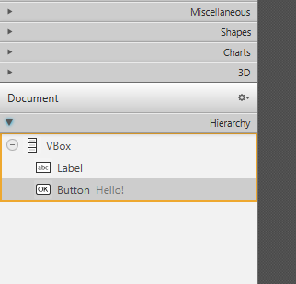
How to use SceneBuilder
The “Hierarchy” tab is an important component of SceneBuilder.
Here you can see an interactive tree where you can drag and place the objects and containers you have on the stage.
This is very helpful when you need to rearrange your GUI object layering with great accuracy and less mistakes.
You can still move objects and containers on the stage as well. Let’s look at the right side of SceneBuilder now, to see how object properties can be modified.

Slide 25
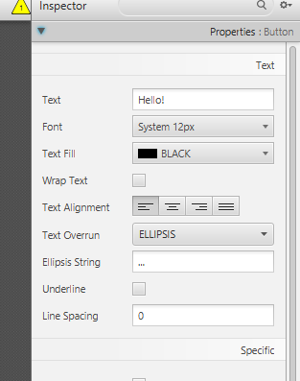
How to use SceneBuilder
The “Properties” tab allows you to change display aspects of an object or container.
Notably, we can see that we can change the text and color located on the object as it will be seen on the GUI.

Slide 26
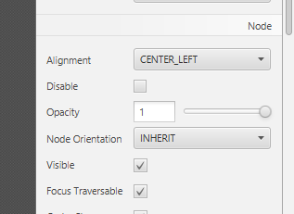
How to use SceneBuilder
Additionally, “Properties” is where you can set default visibility of an object or container by checking or unchecking “Visible.”
Selecting “Disable” allows you to remove user interactivity with the object. This is useful for things like Text Fields, where you might want to show the user some text but not want them to be able to write text in it as well.

Slide 27
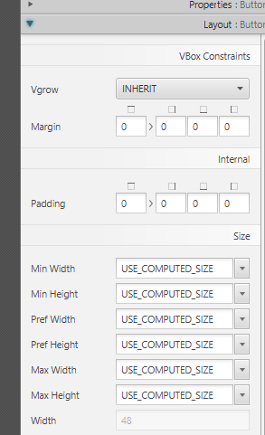
How to use SceneBuilder
The “Layout” tab lets you control things like the object’s relative size and positioning to your GUI window.
Padding and margin options give you the ability to modify the spacing collision boundaries between elements.
Combined with the previously mentioned “Hierarchy” tab on the left, layouts can be very precise.

Slide 28
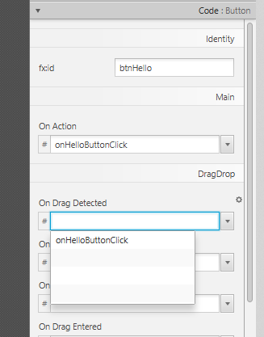
How to use SceneBuilder
Finally, we take another look at the “Code” tab we used before to set up the fx:id for btnHello. This section can do a lot more than name variables.
You can scroll through a list of fields representing events that you want to make listeners for. By clicking inside the desired event you can select a method in your controller class to link the event to or simply write your own.
Make sure that after you have made changes that you update your controller class!

